Slide 1
Vulnerable Children Legislation
Amendments to the Children, Young Persons, and Their Families Act, 1 July 2016

Slide 2
Key amendments to the CYP&F Act
Ensuring the safety of subsequent children
Permanent caregiver support:
Special guardianship
Financial and other assistance for permanent caregivers
Assisting care-leavers to achieve independence
Family group conferences, court plans and reports

Slide 3
Ensuring the safety of subsequent children
Child, Youth and Family has new obligations in cases involving people who have previously:
had a child or young person removed due to abuse or neglect and who have no realistic possibility of caring for that child or young person again, or
been convicted of the murder, manslaughter or infanticide of a child or young person in their care
and who go on to parent another child.

Slide 4
Subsequent Children - New Obligations
We are required to assess parents who meet these criteria and have, or are likely to have, their subsequent child (under age 14) in their care
The assessment’s focus is on whether we think they will inflict, or allow to be inflicted, the kind of harm the previous child or young person experienced
We must apply to Court
Court makes the determination
Other concerns can be assessed concurrently -
the usual process applies.

Slide 5
What permanent caregivers told us
You need support to be available when you need it
You need expert people to offer advice and assistance
You want to be able to access a range of support services in your locality
You want to understand what supports you're able to get
You want the supports to be fair and consistent around the country.

Slide 6
Who can access Permanent Caregiver Support?
From 1 July 2016, a “permanent caregiver” will be legally defined as either:
a special guardian, or
a person who has obtained orders under the Care of Children Act in substitution for custody orders or a section 140 agreement under the Children, Young Persons, and Their Families Act.
*Caregivers who provide a permanent living arrangement with no legal orders after the discharge of our custody will be defined by CYF as a Permanent Caregiver.

Slide 7
The Permanent Caregiver Support Package
Payment of reasonable legal costs
A $2,500 upfront payment (and baby starter package where applicable)
Access to the National Caregiver Training Programme
Financial support from Work and Income
Individualised and needs led support plan for up to the first 12 months
Referral to the Permanent Caregiver Support Service
Ability to comeback & access financial & other
assistance (under s388A CYP&F Act) for future needs
up until the mokopuna reaches 17 years old

Slide 8
Permanent Caregivers - Future Needs
The criteria for making decisions regarding future support needs are in Section 388A(2) of The CYP&F Act. Section 388A obliges the CE to ensure the provision of financial and other assistance to permanent caregivers of mokopuna that:
arises as a result of the child’s care and protection needs, or as a result of extraordinary health, education or developmental needs and
is more than what is reasonable to expect the caregiver to fund and
cannot be met by existing sources of support and is unlikely to be provided otherwise and
is reasonable to be provided by the CE and
the provision of assistance is consistent with any general or
special directions given to the CE in writing by the Minister.

Slide 9
Permanent Care - Legal arrangements
There are new legal options available to you:
Get independent legal advice in considering legal options to secure permanency
We will explain what should be considered in choosing between different guardianship arrangements under CoCA and Special Guardianship

Slide 10
Special Guardianship Order
Day to day care & guardianship & access arrangements in one order
If you want we can apply for the order on your behalf
To vary or change the order special guardians, parents or other guardians have to have a change in circumstances or the child’s circumstances have to be different to get permission from the Court
A special guardian can apply to the Court to have exclusive rights for specific issues but only if its in the best interests of mokopuna and…
If the permanent living arrangement for mokopuna changes you have to tell us

Slide 11
Assisting Care Leavers to Achieve Independence
New obligation to support young people preparing to leave care to enable them to successfully transition to independence
This support includes:
robust planning for transition from care
use of extended care agreements
accessing advice and assistance post care.

Slide 12
Planning for the Transition from Care The Plan for Independence
The Plan for Independence must be developed for all young people in care, aged between 15 and 17.
The following areas will be included in the Plan:
education, training and employment
networks of support (relationships)
safe living arrangements
financial support
health and wellbeing needs
culture and identity
life skills
official documentation.

Slide 13
Advice and Assistance Post Care
Young people who have left care can come back and ask for advice support and assistance right up until age 20
Support will be based on an assessment of their needs
We must:
consider what other services and supports are available
support the young person to access these services
Access to support is available via:
Child, Youth and Family’s contact centre
the young person’s previous or nearest Child, Youth and Family site

Slide 14
FGC, Court Plans and Reports
What will be clearer:
the social worker’s assessment regarding the likelihood of a child or young person returning home
the outcomes, timeframes and review dates
the parent, guardian or caregiver/s responsibilities and personal objectives
the child’s or young person’s responsibilities and personal objectives (as appropriate).

Slide 15
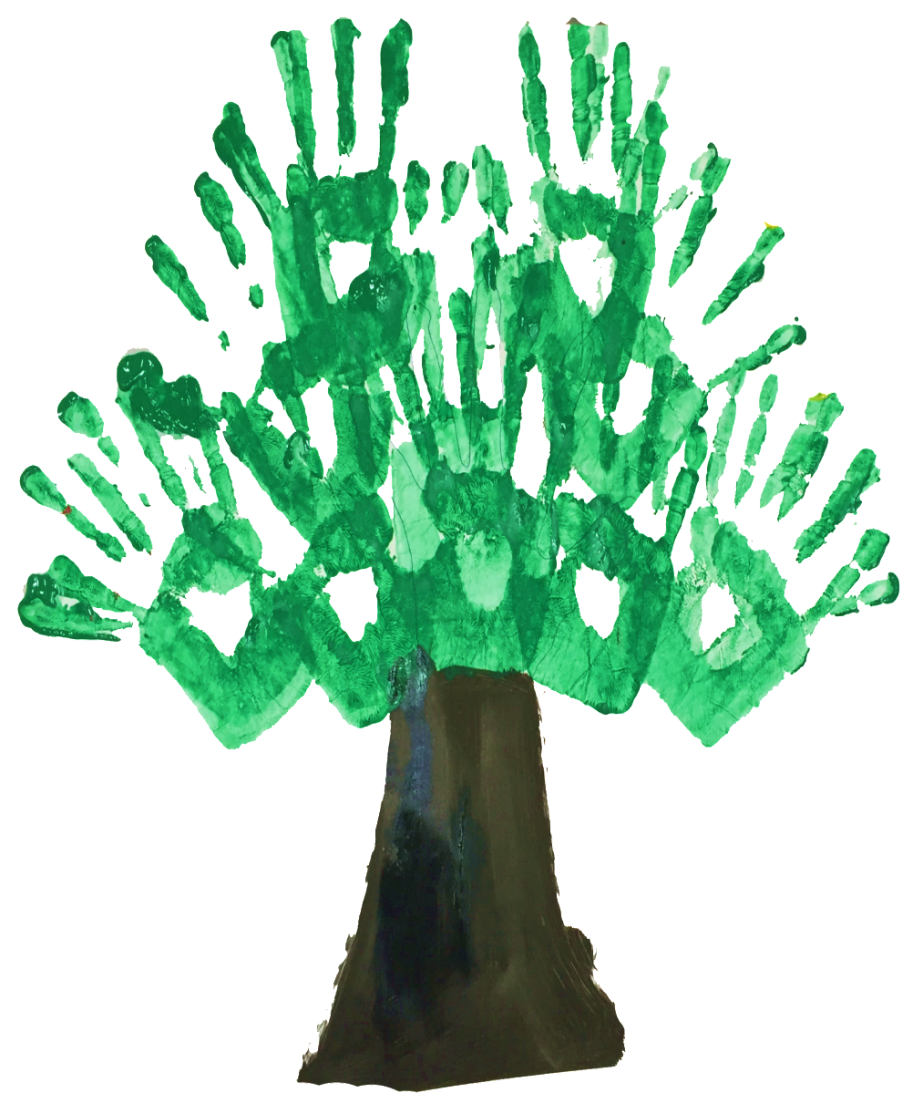
Investing in Children Programme
Vision:
“New Zealand values the well-being of our children above all else.”
Purpose:
“To ensure that all children and young people are in loving families and communities where they are safe, strong, connected, and able to flourish.”

Slide 16
Building Blocks of the Future System
There are six key building blocks of the future system…
Engaging all New Zealanders
A child-centred system
Strategic partnering
An investment approach
High aspirations for Māori
A trauma-informed professional practice framework

Slide 17
Child-Centred System
Six objectives for a child-centred system:
Ensuring that children have the earliest opportunity for a loving and stable family.
Addressing the full range of needs for each child.
Preventing victimisation of children.
Helping children to heal and recover.
Supporting children to become flourishing adults.
Helping children and young people to take responsibility for their actions and live crime-free lives.

Slide 18
Care Support
Children need a loving stable family usually with their birth family
Early decisions about their care need to be made
A planned and supported approach to care placements
A larger and more diverse pool of caregivers and caregivers families
Trusting caregivers as leading participants when key decisions are made for the child

Slide 19
New Ministry
The Ministry for Vulnerable Children – Oranga Tamariki comes into effect on 1 April 2017.
Stand alone agency, that will incorporate Child, Youth and Family, Community Investment, and the Children’s Action Plan.
The new ministry:
signals a whole of sector approach
provides a single point of accountability
has a broader remit, including prevention as a core area of focus
The inaugural CE, Gráinne Moss came on board on 5 Sept 2016.

